Slide 1
Global Movie Industry
Author
Institutional Affiliation
Instructor
Course code
Date of submission

Slide 2
General information on the global movie market
The global film industry comprises the technological and commercial institutions involved in the production of films and distributions.
Globally, Hollywood is the leading film producer and remains the largest in terms of revenue accrued over time.
In contrast, Indian cinema is also significant in the film industry for having produced a significant number of films.
As of 2018, the global film industry was worth 136 billion US dollars.
According to the information drawn from the Motion Picture Association, mobile entertainment accounted for over 59 billion dollars in revenues globally

Slide 3
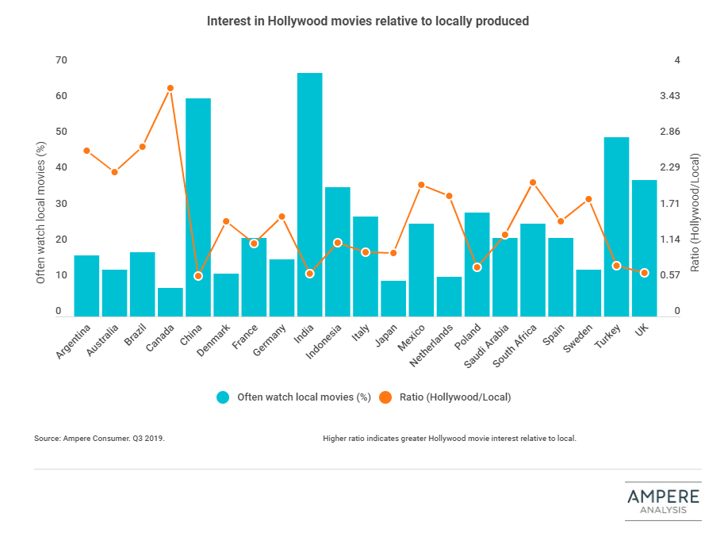
A graphical representation of World Movie Production

Slide 4
Cont..
The global movie industry continues to innovate and deliver great storytelling for movie and TV fans when they need it.
With observably increasing viewership, the industry is expected to experience monetary gains in the coming years.
Reports on the global trends in the movie industry indicate a significant shift towards streaming services thereby increasing the revenue realized from the digital home and mobile entertainment.
The global movie industry consisting of theatrical and home entertainment, according to reports for the first time hit a maximum of 101 billion dollars in earnings in 2019.

Slide 5
Cont..
Observably, the top three regions in the global movie industry include; the Asia-Pacific region with 14.9 billion dollars, the USA and Canada with 11.4 billion dollars, and Europe, Middle East and North Africa with 9.5 billion dollars.
As of 2011, the countries globally with the largest number of film productions were India, Nigeria and the United States. Hollywood has maintained a significant performance over the years grossing over 10 billion dollars or more each year.

Slide 6
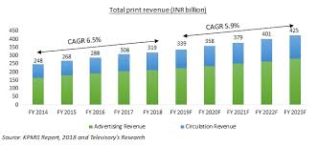
An Image showing Revenues Trends in the film industry

Slide 7
Cont..
In 2018, the French film industry had an international box office of 237 million pounds with Italy being the foreign market.
Similarly, China has also grown to become a major hub of business for Hollywood studios. In 2014, the country’s gross box office was about 4.82 billion dollars with the domestic film industry contributing about 55%.
For the first time in history after 20 years, the global film industry was projected to lose 32 billion dollars in 2020 due to the outbreak of the pandemic.
According to reports in the industry, the global movie industry experienced a reduction in box office revenue by 71.5%. even though there were reductions in the box office revenues globally, there has unprecedented growth in online video usage with revenues increasing by approximately 30%.
The decline in revenues has been mainly due to the bottleneck of new releases due to theatrical appearances.

Slide 8
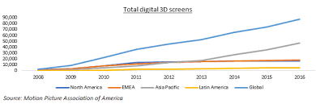
Image showing movie production by region

Slide 9
The influence of American movies
Nowadays films occupy a significant of the media products that people consume.
In the US, film products are considered a key factor in individual and social transformation.
The American media content significantly influences the attitudes of people towards topical social issues (Nabi & Oliver, 2009).
Similarly, the question of the effectiveness of the film content’s effects remains an open question in psychological science.
Psychologically, people’s views and personal opinions tend to be significantly influenced after watching certain types of movies.
Arguably, going to cinemas has been found to be the most common way of spending leisure times.

Slide 10
Cont..
In countries such as Russia, movie cinemas have become important tools for broadcasting state ideology to the masses and is also considered a means of individual and social transformation.
In this sense, the American films have to a greater extent influenced individual behaviours by contributing to the assimilation of commonly accepted values, norms and forms of behaviour.
Gerbner et al. (1986) argued that there is a relationship between what is broadcast in the media and the reality regarding people’s attitudes.
Evidence obtained from a plethora of past research indicates a significant influence of movie content on the beliefs, opinions, stereotypes and attitudes of individuals.

Slide 11
Cont..
Behm & Maestro (2008) observed that cinema portrayals in the US significantly changed the attitude of the people towards certain groups of people thereby causing newly formed opinions on various issues.
Harris (2002) observed that based on HIV films in the US, many people have developed sympathy for the people living with the disease.
TV series depicting transgender characters have contributed to the development of positive attitudes towards transgender persons in the country.
Also, viewing films and other cinema contents about the minority people in the US have acted to a greater extent in inducing positive attitudes towards them and increased ethnic tolerance (Forge & Phemister, (1987).

Slide 12
Cont..
Movies act as mirrors to the cultural values of the society. Films have for instance taught teenagers the most important cues of social interaction.
An example is CLI-fi movies. The film Bambi (1942) depicted a mother deer being killed by a hunter before her baby's eyes.
After the film was in theatres, deer hunting in the US was cut in half. Furthermore, the psychological effect that comes from anthropomorphizing "cute" animals got its informal name from the movie: the Bambi effect (Platt College, 2021).
The American’s films are not only viewed in America, but they are viewed by the massive audience around the world.
Additionally, the American film firms dominate the majority of market share in the world film industry. The promotion of American movies through Hollywood has been seen as a representation of cultural imperialism.

Slide 13
Trends in the international movie market
The global movie industry is constantly witnessing new trends which revolve around the incorporation of new technologies and getting rid of out-of-date technologies and techniques of productions.
Recently, there has been an upsurge in smaller budget films. The use of platforms such as Netflix, YouTube, and Amazon original has considerably increased in contrast to the past.
Similarly, the movie industry has also embraced increased social commentary to focus on relevant social issues and fostering unity among the people.
Example of the films on social commentary can include: The Moonlight addressing race and LGBTQ issues in the society and Get out, a film on race relations.
Lastly, the latest trend in the global movie industry is that American film content is increasingly finding its way into movie theatres and homes globally.
With the growth of internet technology, the rapid spread of these movies across the globe has been viewed as unfair competition that amounts to cultural imperialism.

Slide 14
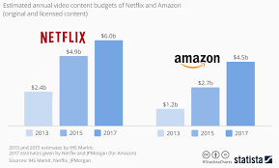
The use of web-based services has been increasing over the years

Slide 15
The movie market in Europe
Compared to the United States, the movie market in Europe holds approximately 29.4% of the global market share.
The film industry in Europe has been largely dominated by the UK. The film production in Europe continues to flourish with the sector realizing a 17 % increment in earnings in the year 2019 (European Film Forum, 2021).
This is indicative of the high levels of confidence that international filmmakers have in the region’s creativity, expertise and world-class production.
Europe has fair tax laws. The UK for instance has a film tax relief which has also acted as a motivating factor for increased production in the country.
Major international films such as Avengers, Endgame and James bond have all contributed significantly to the region’s growth in the global film industry.

Slide 16
Cont..
For the 9th consecutive year, the region has witnessed an increase in box office earnings with over 200 million tickets sold.
The UK is a major player in the European film industry generated a turnover of 14.8 billion pounds in 2017 with a global theatrical market share of just over 42 billion dollars, indicative of a 24.6% share.

Slide 17
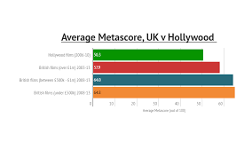
An image showing the performance of the UK film

Slide 18
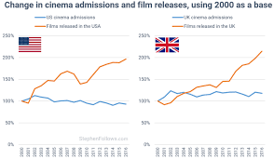

Slide 19
Discussion Questions
Which statement best describes the UK film industry?
The country’s performance is lower than France Film industry
UK has had a steady increase in box office earnings over the last few years
The tax policies in the country do not support increased production
b. Is the global Film industry Growing?
Yes
No
The global film industry is subject to prevailing conditions such as health and political conditions, hence it is difficult
c. What impact do movies present on our lives?
Helps in the reflection of the society and the transformation of opinions
There is no direct correlation between movies and how we behave
Movies are consider leisure activities that help us bond with our friends.

Slide 20
d. What is the significant impact of the pandemic on the film industry?
The pandemic has resulted in significant reduction of box office revenues globally
The pandemic has presented no significant on the film industry since the global viewership has remained constant during this period
None of the above
e. Discuss the impact of Movies on culture
Just as movies reflect the anxieties, beliefs, and values of the cultures that produce them, they also help to shape and solidify a culture's beliefs. Sometimes the influence is trivial, as in the case of fashion trends or figures of speech.
Watching of movies may cause abandonment of cultures.
Movies ideally help us in shaping our social cues

Slide 21
References
The National Lottery. Facts and Stats in the EU film industry. (2021). Retrieved from: https://www.weareukfilm.com/facts-and-stats
Harris, R. (2002). Psychology of mass communications. S-Pb.: Praim-Evroznak, 448.
Nabi, R. L., & Oliver, M. B. (Eds.). (2009). The SAGE handbook of media processes and effects. Sage.
Behm-Morawitz, E., & Mastro, D. E. (2008). Mean girls? The influence of gender portrayals in teen movies on emerging adults' gender-based attitudes and beliefs. Journalism & Mass Communication Quarterly, 85(1), 131-146.
Forge, K. L., & Phemister, S. (1987). The effect of prosocial cartoons on preschool children. Child Study Journal.
Oliver, M. B., Raney, A. A., & Bryant, J. (Eds.). (2019). Media effects: Advances in theory and research. Routledge.

Slide 22
Platt College. (2021). Film and Society: How Films Impact Society and Popular Culture. Retrieved from: https://platt.edu/blog/film-society-films-impact-society-popular-culture/
The Los Angeles Film School. (2021). Trends in the Film industry. Retrieved from: https://www.lafilm.edu/blog/5-emerging-trends-film-industry/
The European Film Forum - Shaping Europe’s digital future - European Commission. Shaping Europe’s digital future - European Commission. (2021). Retrieved 15 February 2021, from https://ec.europa.eu/digital-single-market/en/european-film-forum.
World Heritage Encyclopedia. (2020). CINEMA OF EUROPE. Retrieved from: http://self.gutenberg.org/articles/cinema_of_europe?view=embedded
Gerbner, G., Gross, L., Morgan, M., Signorielli, N., Bryant, J., & Zillmann, D. (1986). Perspectives on media effects. Living with television. Hillsdale: Erlbaum.

